Slide 1

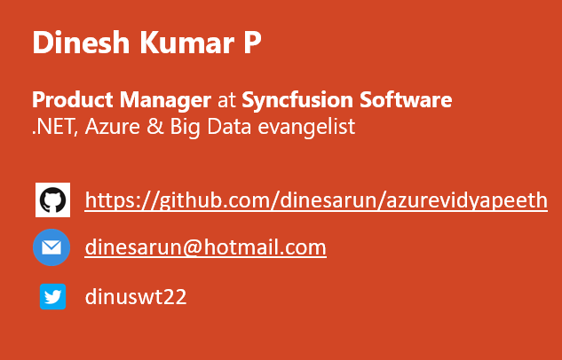
Big Data Projects
Notes:
Good afternoon guys. Ya. I am Dinesh Kumar. Product Manager at Syncfusion Software. I manage ‘Data sources’ division of Data Platform team. And I am pretty happy to present this Webinar in Azure Vidyapeeth to this wonderful audience. Here we go!

Slide 2

Apache Hadoop
* PROCESS and STORE data in a distributed computing environment (commodity hardware).
* Fault tolerant (Data & Processing)

Slide 3

Apache Pig
* A scripting platform (Pig Latin) for processing and analyzing large data sets.

Slide 4

Apache Hive
* HIVE is a data warehousing component originated @Facebook.
* Hive Query Language(HQL) - very similar like SQL.
* 2 wide spread clients - Hive Command Line and JDBC/ODBC driver.

Slide 5

Apache HBase
* A non-relational column oriented distributed database that runs on top of HDFS.
* Simply say, NoSQL on top of Hadoop.
* Provides real-time read/write access to large datasets. i.e. Over comes random writes, which HDFS does not support.

Slide 6

Apache Sqoop
* Transfer data between Hadoop and relational databases.
* Can handle large size as well and can be parallelized to increase the pace of work.
* Works with several relational databases such as MS SQL Server, Teradata, Netezza, Oracle, MySQL, Postgres.

Slide 7

Apache Oozie
* It is a workflow scheduler system to manage Big Data jobs.

Slide 8

Apache Spark
* Apache Spark is a framework for real time data analytics in a distributed computing environment.
* Spark is written in Scala and was originally developed at the University of California, Berkeley.
* It executes in-memory computations to increase speed of data processing over Map-Reduce.
* Supported APIs – Scala, Python, R, Java.
* Libraries – SQL, Streaming, Machine Learning and Graph.

